Slide 1
Scientific Machine Learning for Modeling, Optimization, and Control
Ján Drgoňa
Associate Professor Civil and Systems Engineering Department Electrical and Computer Engineering Department (secondary) The Ralph O'Connor Sustainable Energy Institute (ROSEI)
Data Science and AI Institute (DSAI)

Slide 2
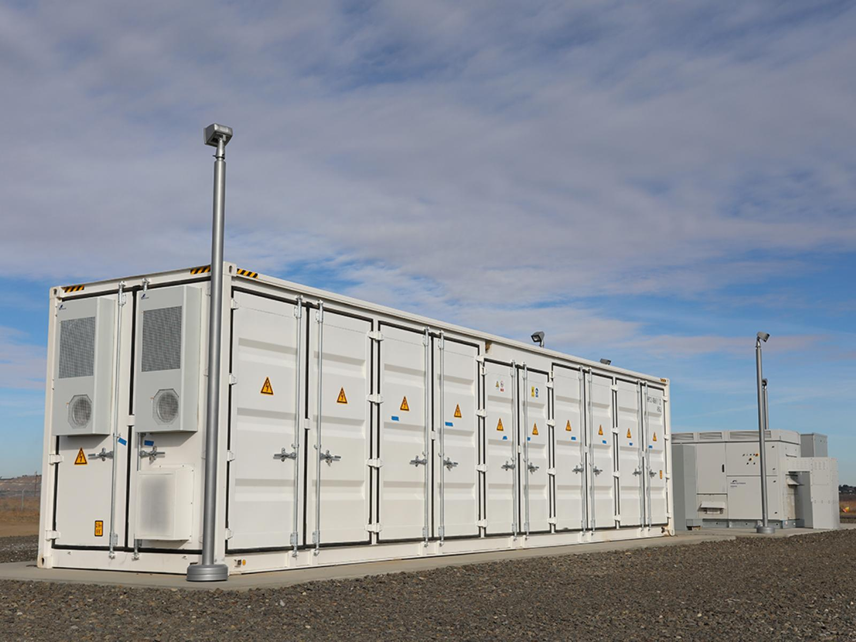
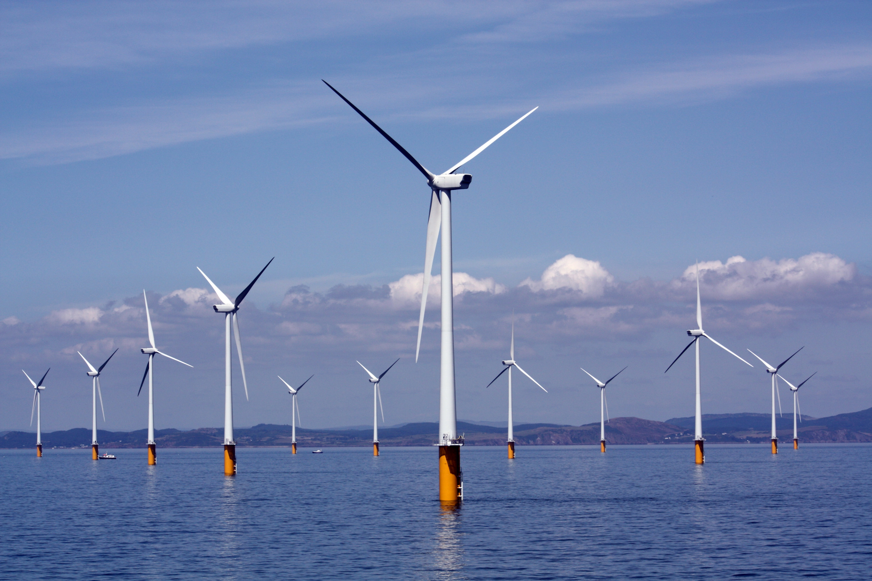
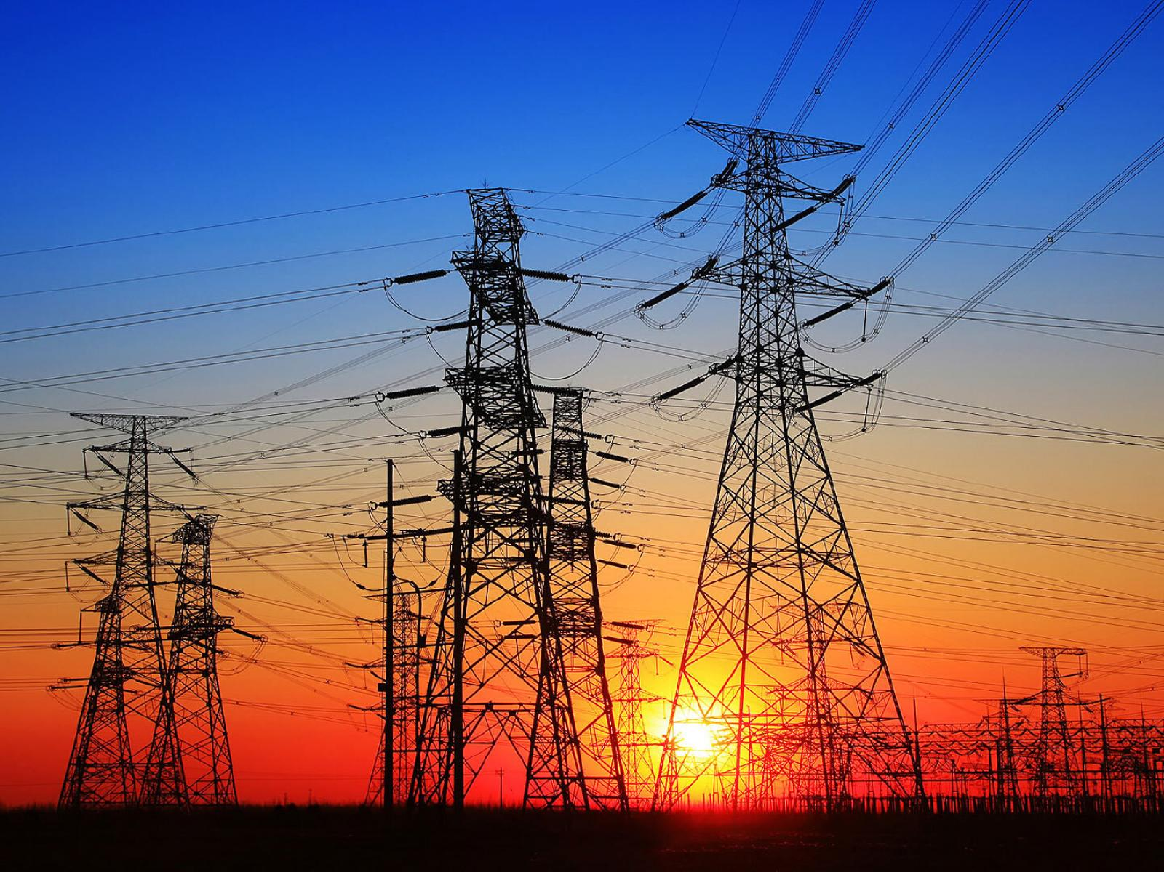

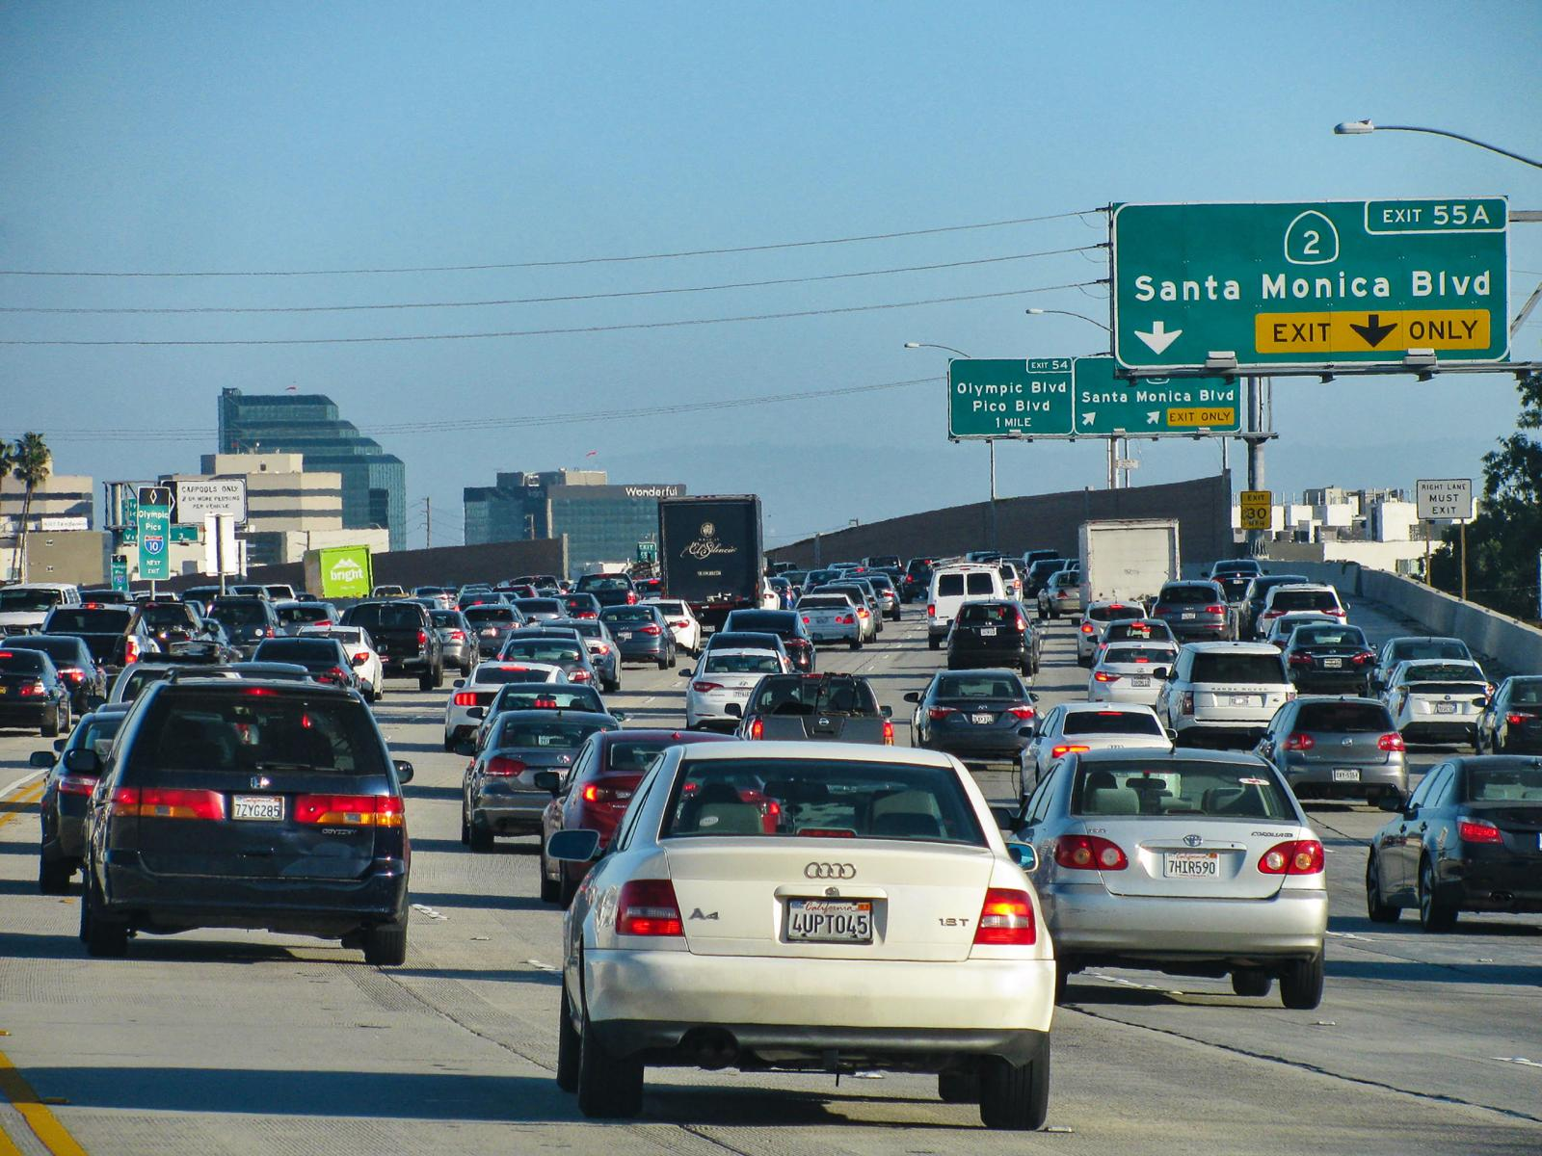
Optimizing Complex Systems with Safety Guarantees is Hard
Simulations are crucial for optimal decision-making in complex energy systems
Need: Improve computational efficiency and scalability of digital twins and optimization-based decision-making
Challenges:
Modeling and simulation of complex systems is hard
Closed-loop decision-making for complex systems is hard-er
Scientific computing and machine learning tools are fragmented and not easily composable
Safety guarantees are critical

Slide 3
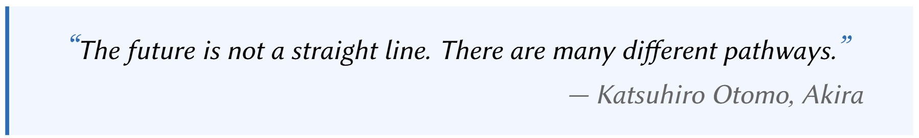

Neural Differential Equations (NDEs)
R. T. Q. Chen, et al., Neural Ordinary Differential Equations, 2019

Slide 4
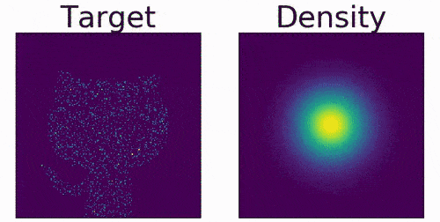
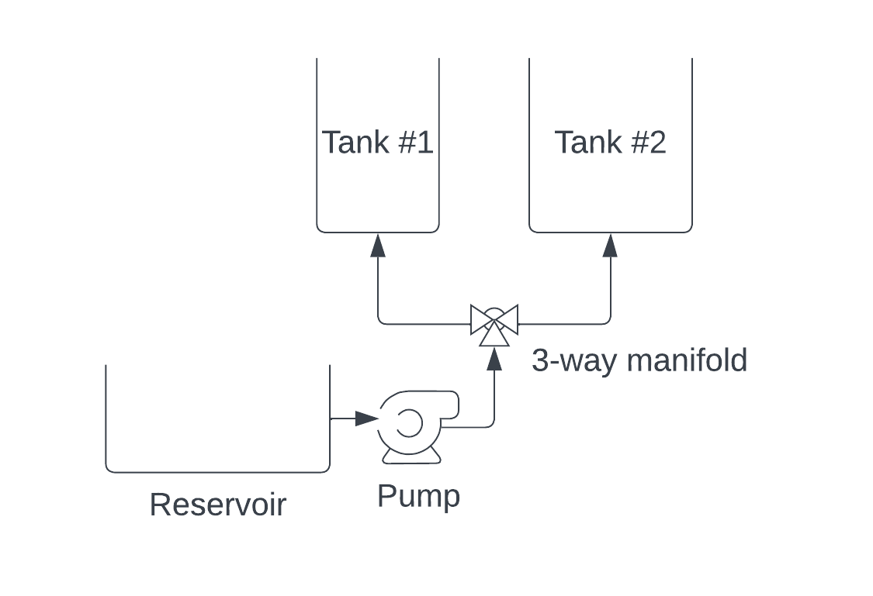
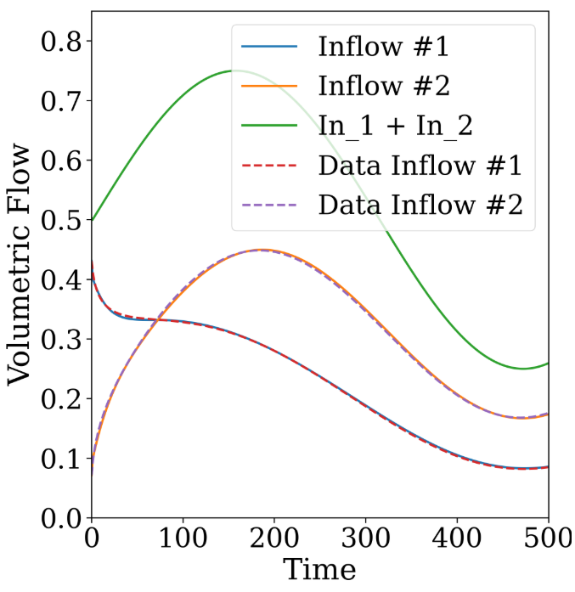
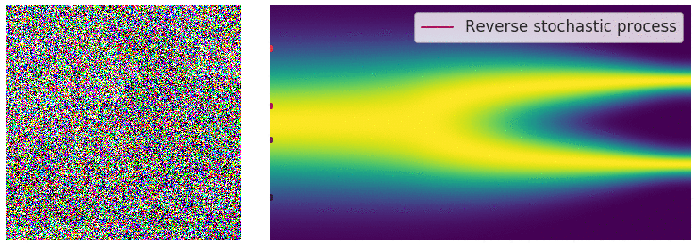
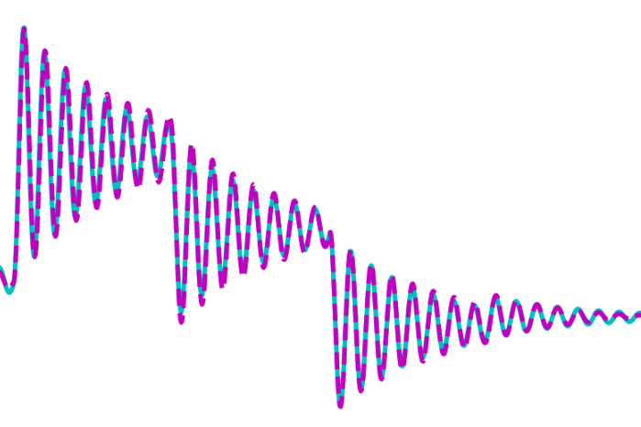
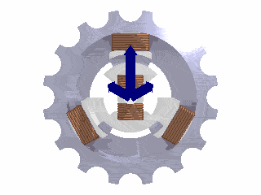
Neural Differential Equations (NDEs) Applications
Generative AI: normalizing flows
Engineering systems modeling
Will Grathwohl et al., "FFJORD: Free-form Continuous Dynamics for Scalable Reversible Generative Models." ICLR, 2019.
James Koch, et al., Learning Neural Differential Algebraic Equations via Operator Splitting, CDC, 2025
Generative AI: diffusion-based models
Power systems modeling
Yang Song, et al., Score-Based Generative Modeling through Stochastic Differential Equations, ICLR 2021. Image from https://yang-song.net/blog/2021/score/
X. Kong, et al., Dynamic Parameter Estimation with Physics-based Neural Ordinary Differential Equations, IEEE PESGM, 2022

Slide 5
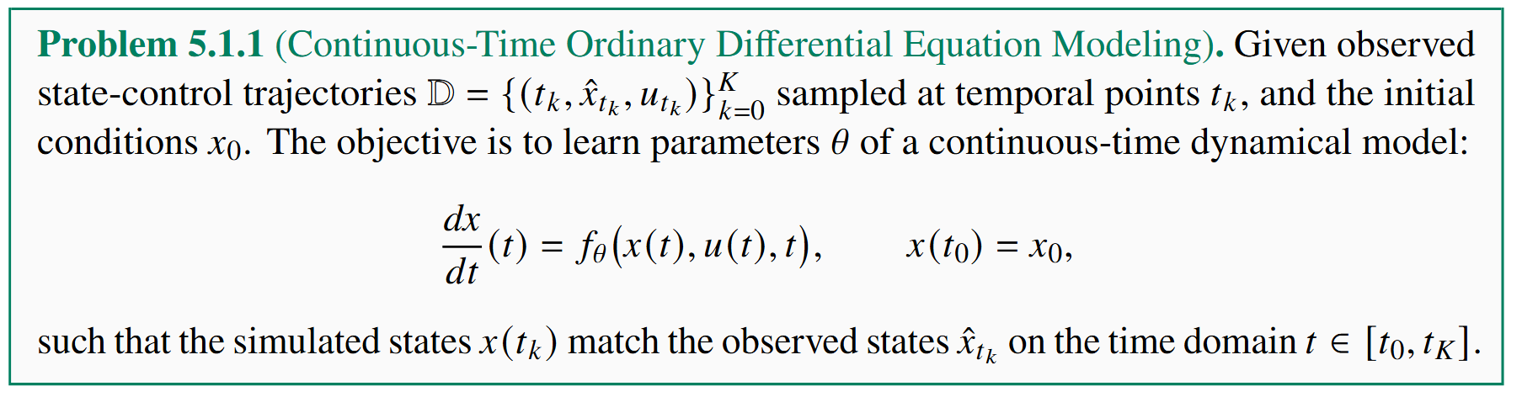
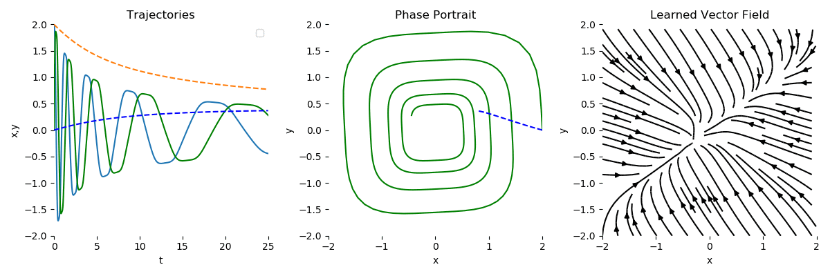
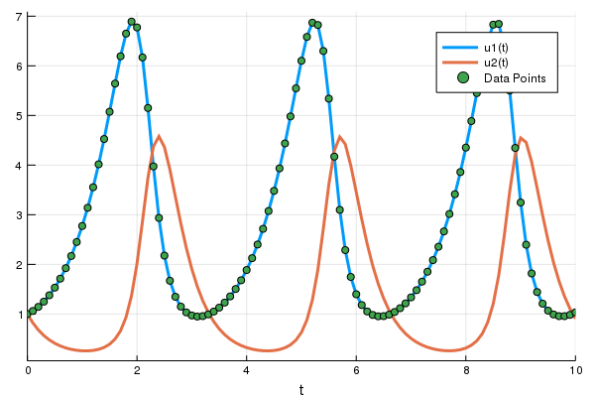
Data-Driven Neural Differential Equations Modeling Problem
R. T. Q. Chen, et al., Neural Ordinary Differential Equations, 2019
docs.sciml.ai/DiffEqDocs/stable/

Slide 6
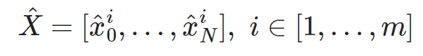
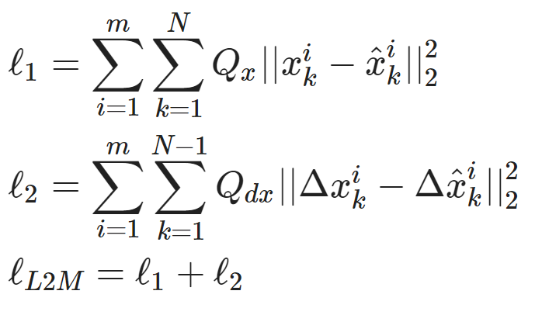
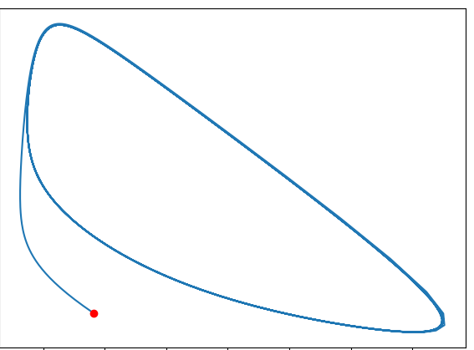
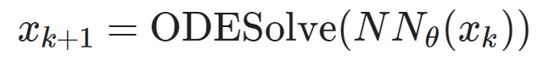
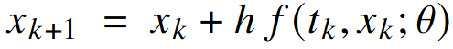
Components of Neural Differential Equations (NDEs)
Dataset: time-series of states, inputs, and disturbances tuples.
Architecture: differentiable ODE solver with neural network model.
Loss function: trajectory matching, regularizations, and constraints penalties.
Explicit Euler ODE solver:
https://github.com/pnnl/neuromancer/blob/master/examples/ODEs/Part_1_NODE.ipynb
R. T. Q. Chen, et al., Neural Ordinary Differential Equations, 2019

Slide 7
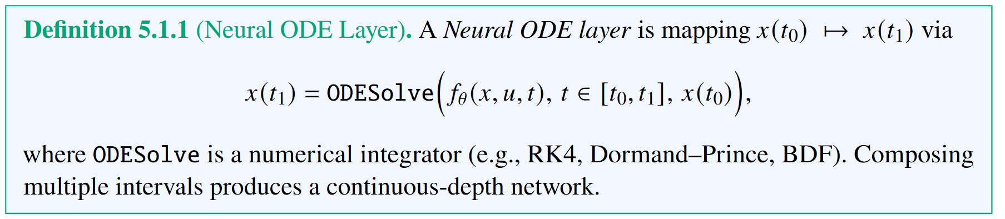
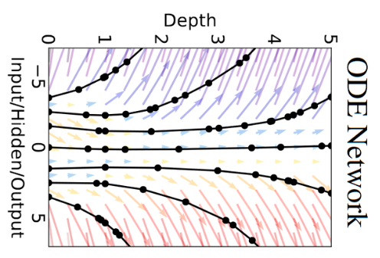
Neural Ordinary Differential Equations (NODEs)
R. T. Q. Chen, et al., Neural Ordinary Differential Equations, 2019

Slide 8
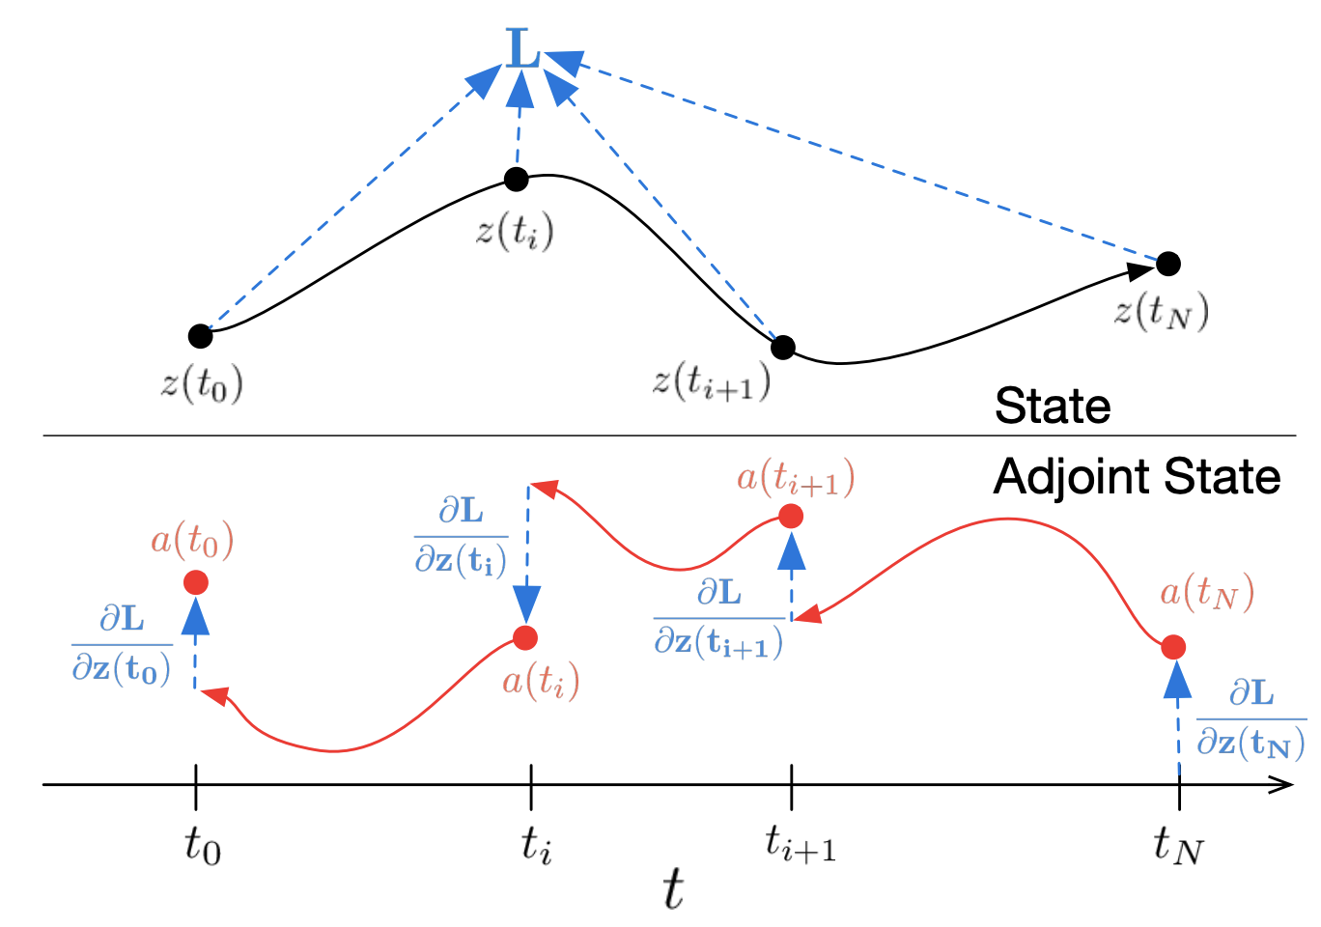
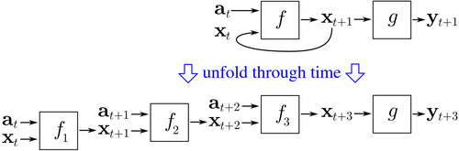
Differentiating Through ODEs Solvers
Backpropagation through time (BPTT)
Adjoint sensitivity method
Pros: exact for discretized systems, numerically more stable, wide support in modern AD libraries
Cons: high memory cost, requires storing all intermediate variables
Pros: memory efficiency, no need to store intermediate variables, strong theory
Cons: error accumulation leading to numerical instability
https://en.wikipedia.org/wiki/Backpropagation_through_time
R. T. Q. Chen, et al., Neural Ordinary Differential Equations, 2019

Slide 9
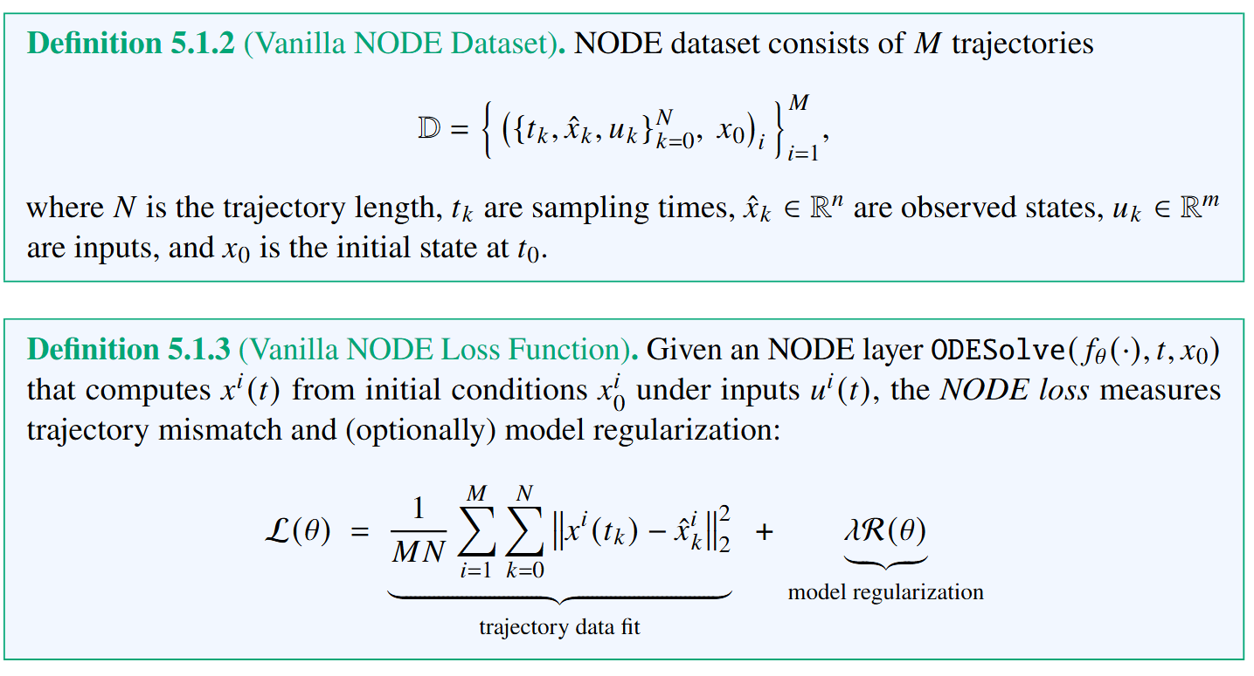
NODE Dataset and Loss Function

Slide 10
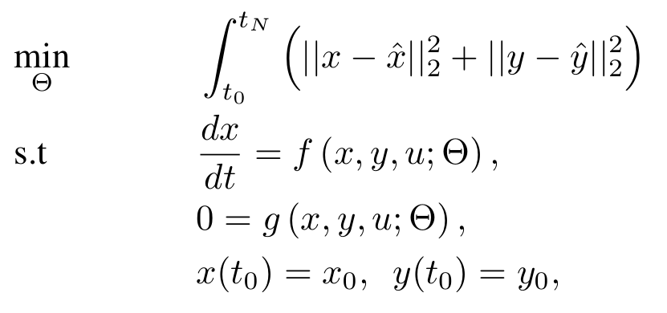
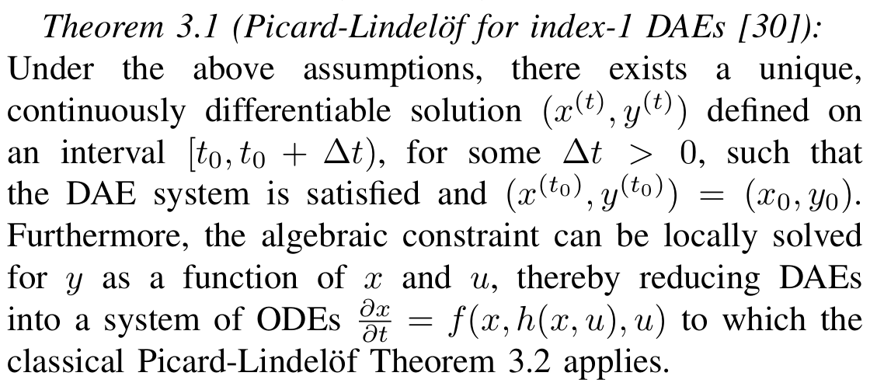
Neural Differential Algebraic Equations (NDAEs) Problem Formulation
DAE parameter estimation problem
The Picard–Lindelöf theorem (also called the Cauchy–Lipschitz theorem) gives sufficient conditions under which an initial value problem (IVP) for an ordinary differential equation (ODE) has a unique solution.
Assumptions:
𝑓 is continuous in both 𝑡 and 𝑥
𝑓 is Lipschitz continuous in 𝑥 on some neighborhood of initial conditions
[30] K. E. Brenan, S. L. Campbell, and L. R. Petzold, Numerical Solution of Initial-Value Problems in Differential-Algebraic Equations. SIAM, 1996.

Slide 11
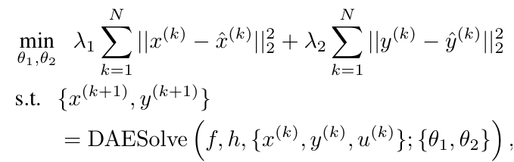
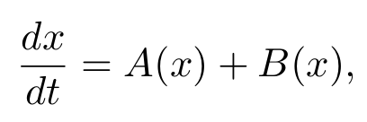
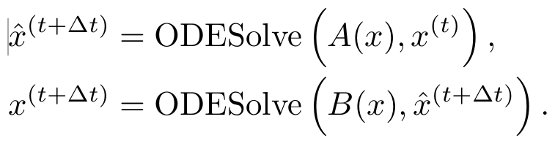
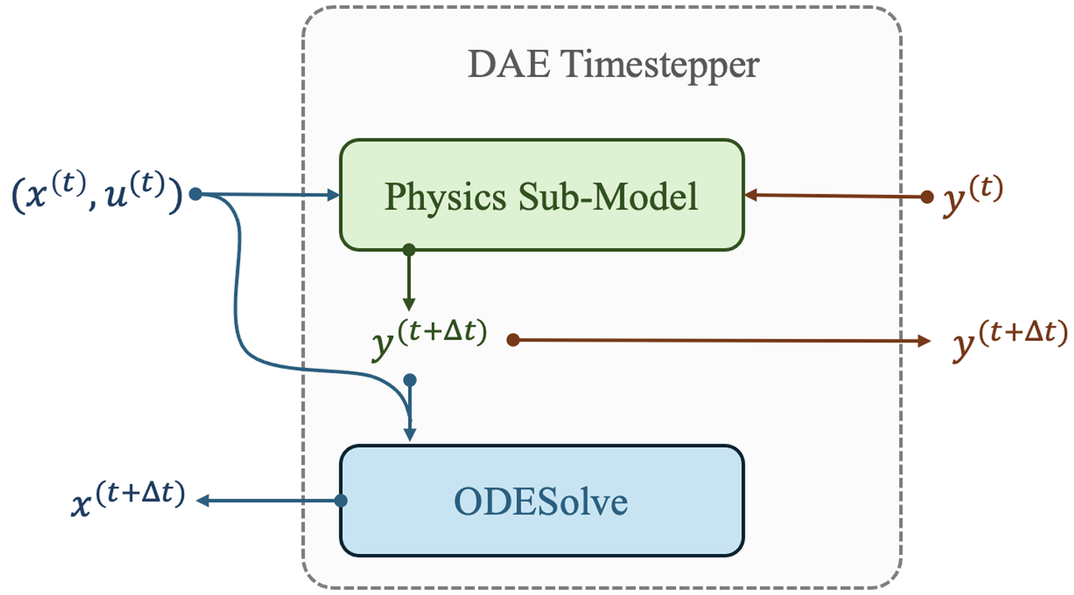
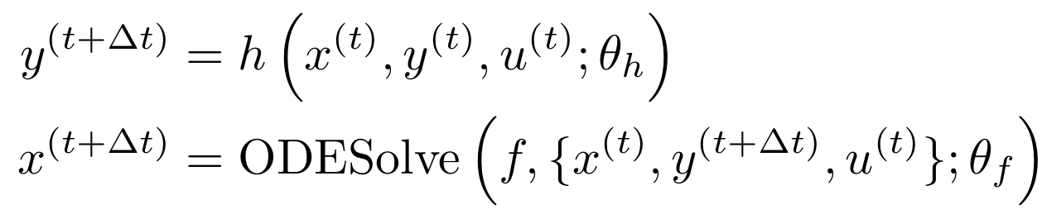
Learning Neural Differential Algebraic Equations via Operator Splitting
Our neural DAE time stepper architecture is inspired by operator splitting methods for ODEs:
Neural DAE learning problem:
Lie-Trotter splitting scheme for ODEs:
Operator splitting for DAEs:
Picard-Lindelof Theorem for index-1 DAEs.
J. Koch, M. Shapiro, H. Sharma, D. Vrabie, J. Drgona, Learning Neural Differential Algebraic Equations via Operator Splitting, arXiv:2403.12938, 2024.

Slide 12
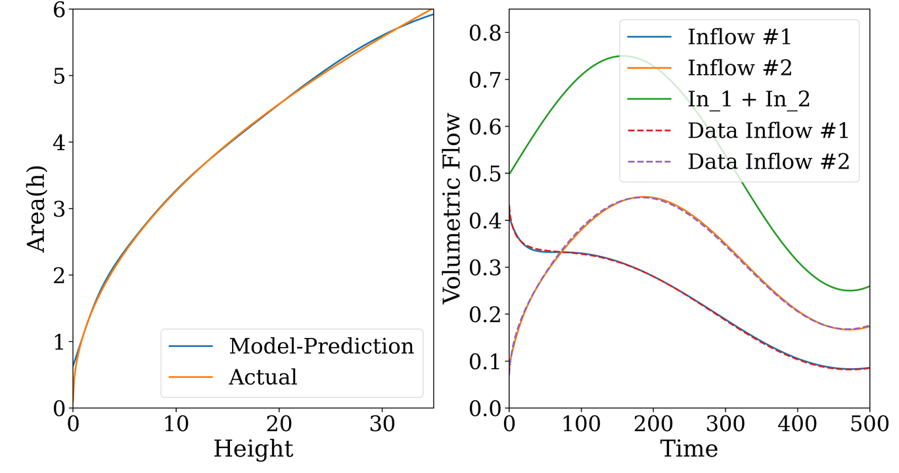
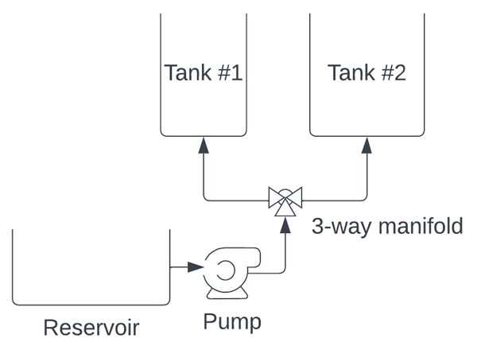
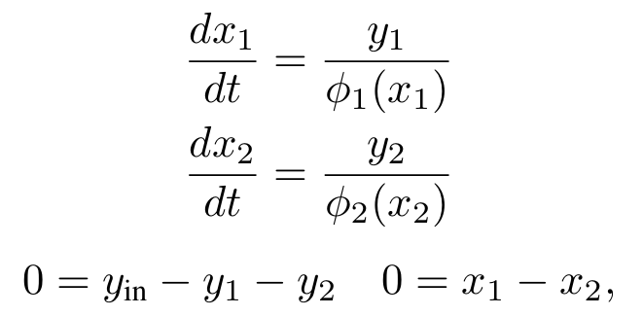
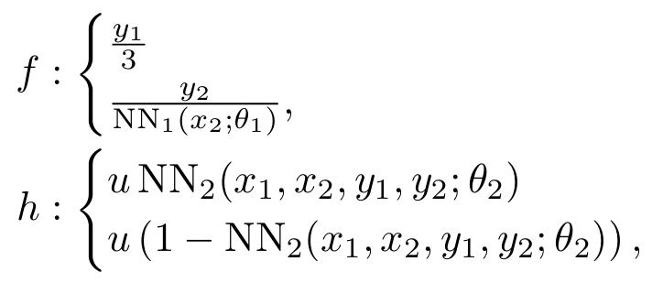
Learning Neural Differential Algebraic Equations via Operator Splitting
Case study: coupled tank modeling
DAE with unknown components:
Neural DAE:
Inverse modeling, robustness to noise and, out of distribution generalization.
drgona.github.io/NeuralDAEs/
J. Koch, M. Shapiro, H. Sharma, D. Vrabie, J. Drgona, Learning Neural Differential Algebraic Equations via Operator Splitting, arXiv:2403.12938, 2024.

Slide 13
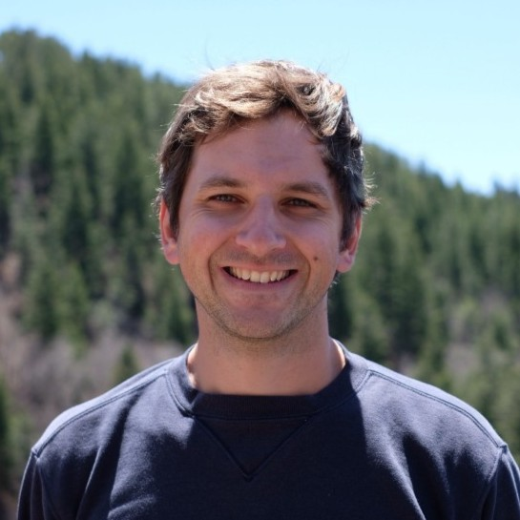
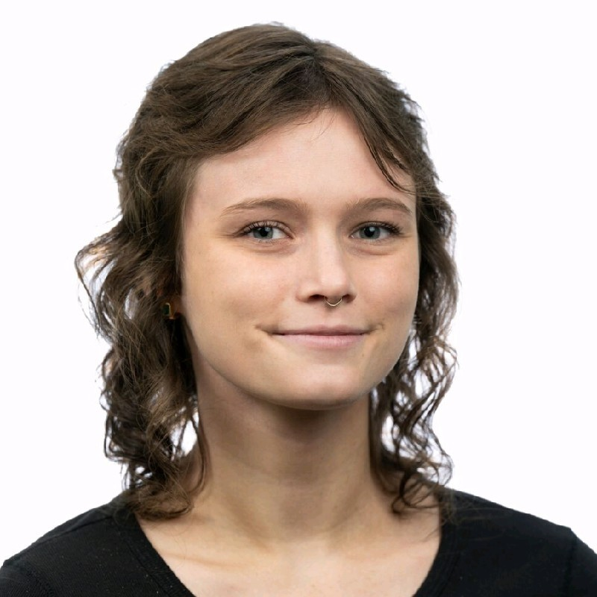
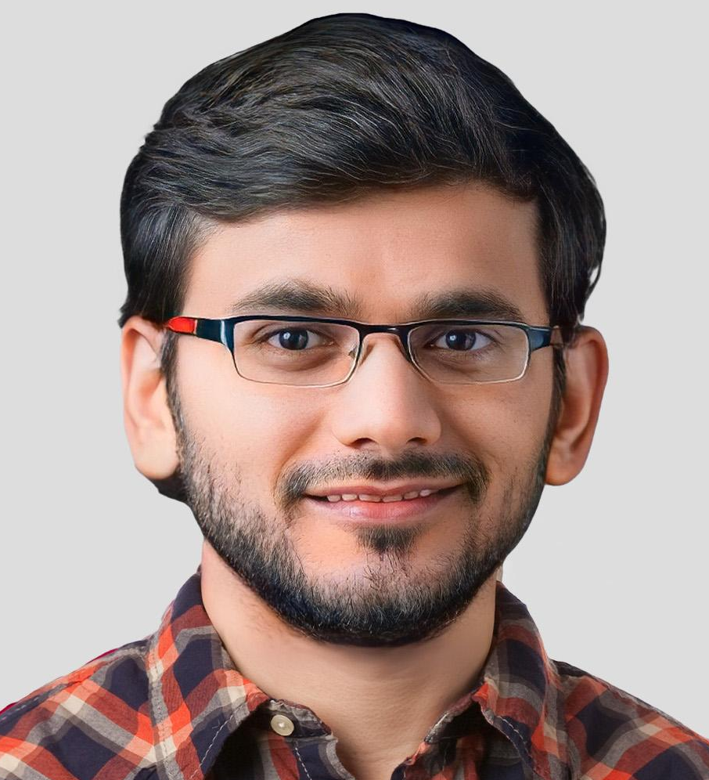

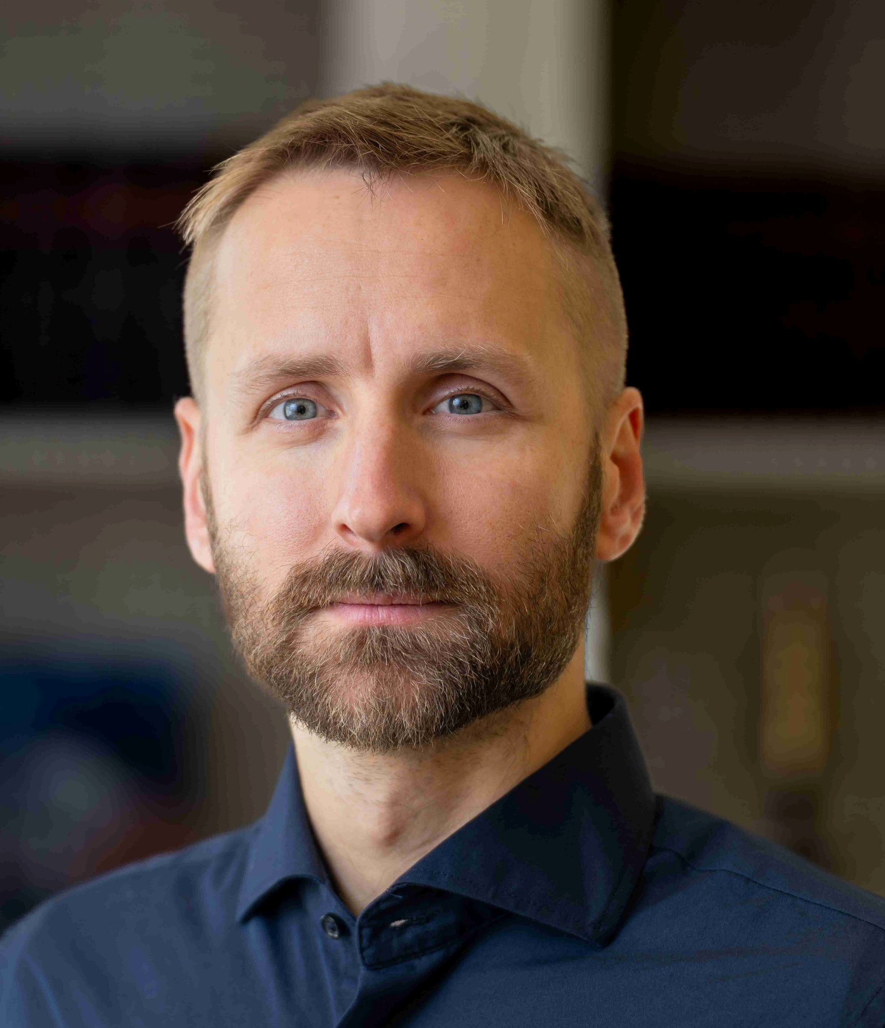

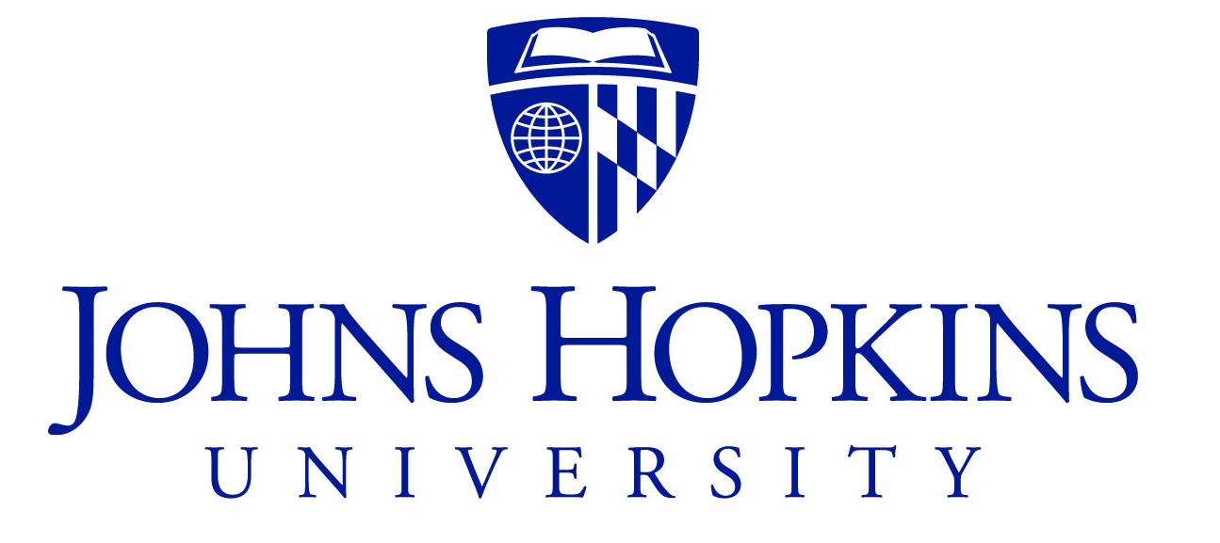

Co-Authors of Learning Neural Differential Algebraic Equations via Operator Splitting
James Koch
Madelyn Shapiro
Himanshu
Sharma
Draguna
Vrabie
Ján Drgoňa

Slide 14

NeuroMANCER Scientific Machine Learning Library
Open-source library in PyTorch
Physics-informed Neural Networks
Learning to optimize
Neural differential equations
Learning to control
github.com/pnnl/neuromancer

Slide 15
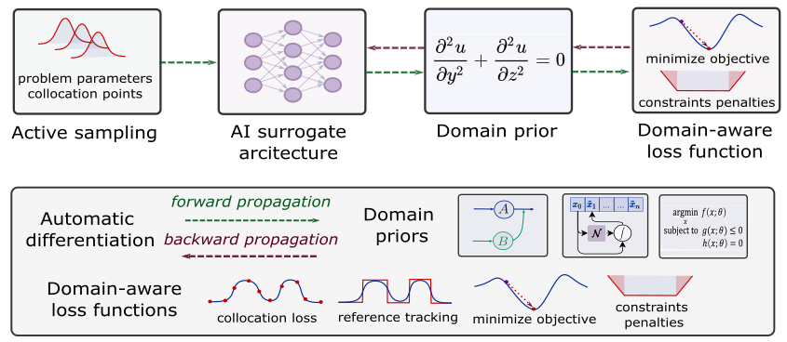

Summary
Scientific machine learning (SciML) methods integrating deep learning, constrained optimization, physics-based modeling, and control
Learning to solve (L2S)
Learning to optimize (L2O)
Learning to model (L2M)
Learning to control (L2C)
Challenges
Mixed-integer equality constraints
Gradients ill conditioning for deep graphs
Offline pre-training vs online adaptation
Computational cost of guarantees
Opportunities
Large-scale modeling, design, and control of sustainable energy systems
PDE optimization and control
Development of new software tools

